Slide 1
Data-Dependent Frames
Windows: based on time or count
Frames: based on data, e.g. Δfluorescence > 0.05

Slide 2
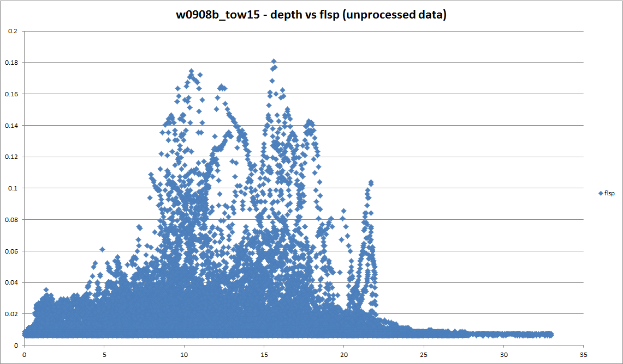
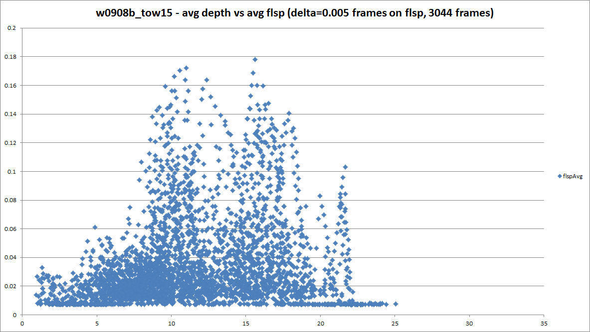
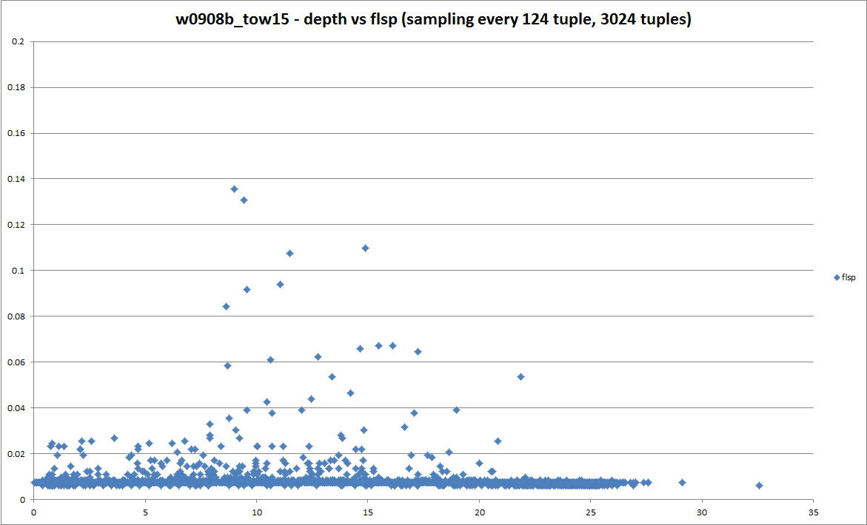
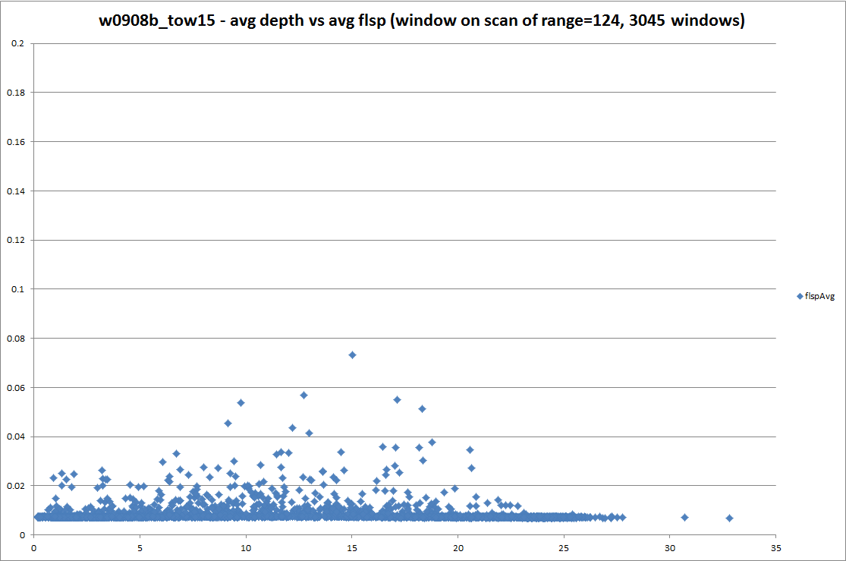
Fluorescence vs. Depth

Slide 3
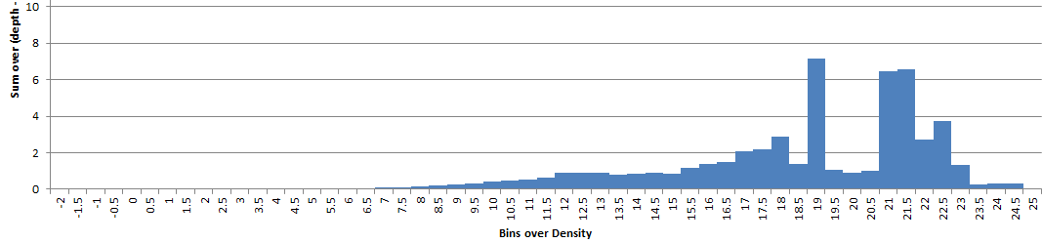

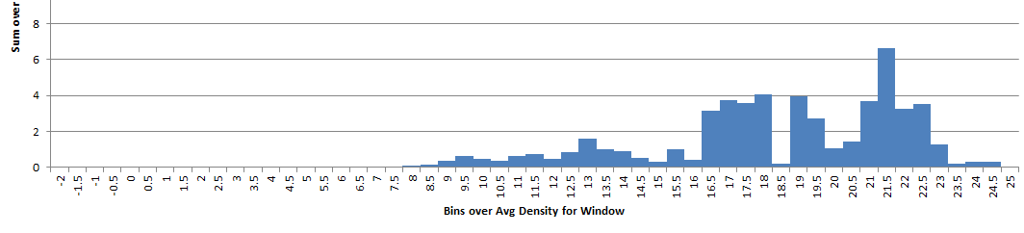
Dye Mass by Density Bins
Reference (~58K tuples)
Dye Mass | Density (1000 frames)
Windows (1000)

Slide 4
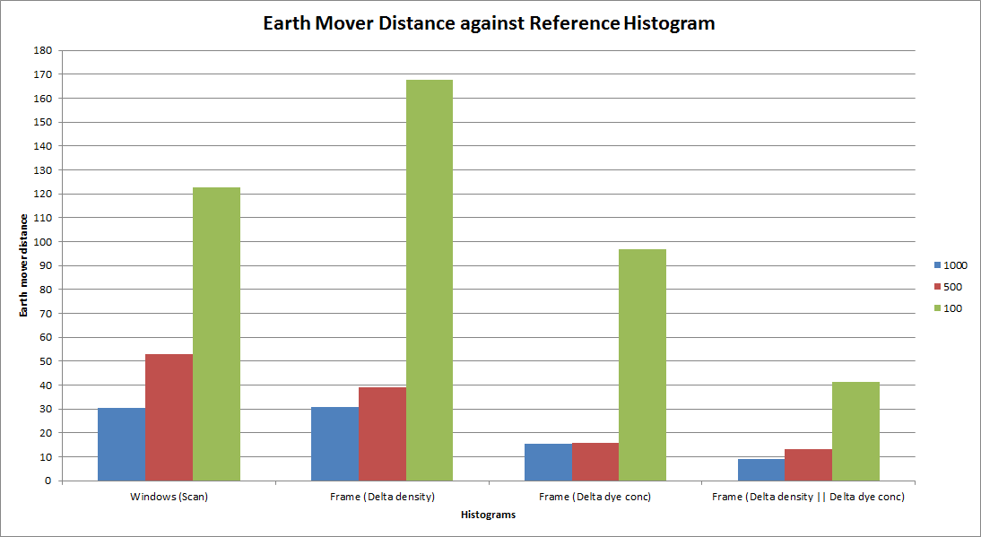

Slide 5
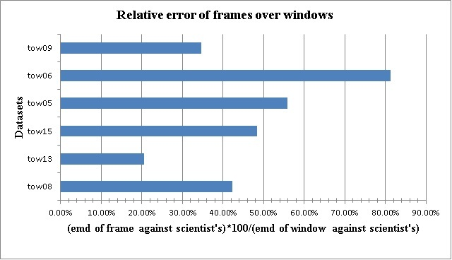
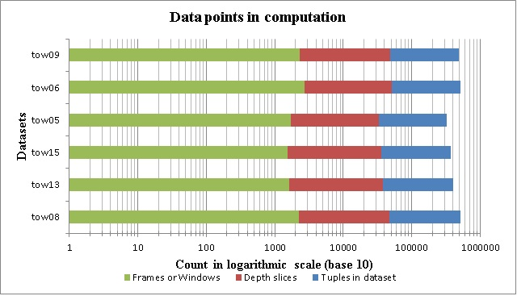

Slide 6
List of graphs (2-7)
Dataset: tow2.txt (57773 tuples)
Scatterplots
Depth vs flsp (original data)
1000 delta frames on flsp
1000 tumbling windows
Xoomed-in versions
Depth vs flsp (original data, 36062 tuples)
1000 delta frames on flsp
1000 tumbling windows
List of graphs (8-13)
Dataset: tow2.cnv (312000 tuples)
Scatterplots
Depth vs flsp (original data)
1000 delta frames on flsp
1000 tumbling windows
Xoomed-in versions
Depth vs flsp (original data, 204229 tuples)
1000 delta frames on flsp
1000 tumbling windows
List of graphs (14-17)
Dataset: w0908b_tow15 (374999 tuples)
Scatterplots
Depth vs flsp (original data)
Delta=0.005 frames on flsp (3044 frames)
Sampling every 124th tuple (3024 tuples)
Tumbling windows (3045 windows)

Slide 7
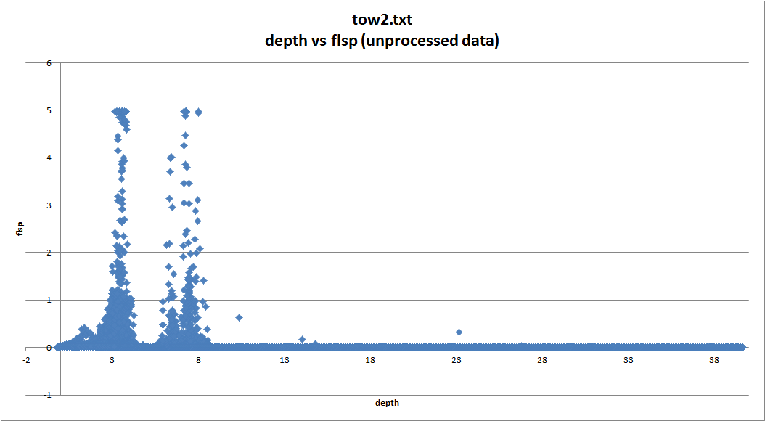

Slide 8
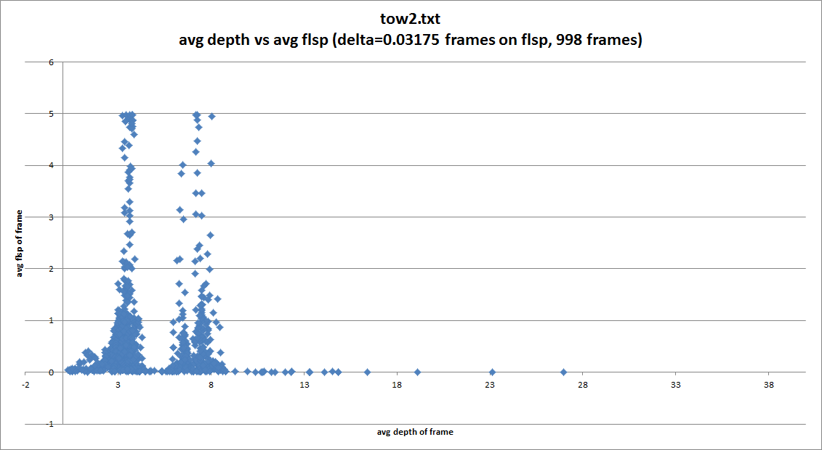

Slide 9
